Slide 1
Personal Loan Risk Model
PDACO61 version
Model Documentation
(DAC internal - Strictly confidential)
Taipei
June, 2006
All rights reserved. No part of this work may be reproduced in any form without the prior written permission from DAC

Slide 2
CONTENTS
Sample definition
Variable definition & range
Model lift charts / KS score
Population distribution by risk segment

Slide 3
DATA SOURCE
Modeling population
FW PL 200307-200309 approved accounts
FW Personal loan
Validation population
FW PL 200304-200306 approved accounts

Slide 4
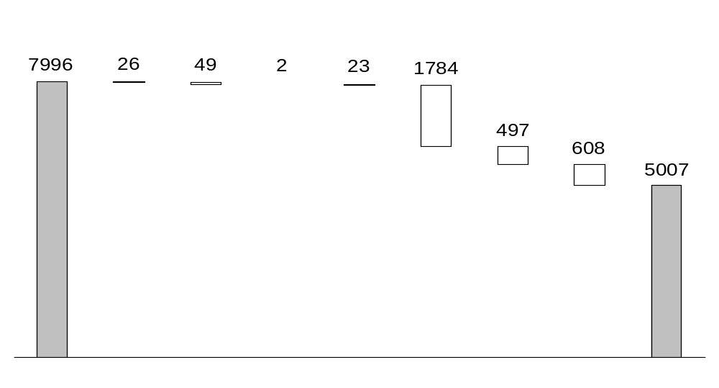
POPULATION SCREENING – MODELING
Screen #
1
2
3,4
5
6
7
8
All approved accounts
Major derog
Credit card bucket>3
BAM bucket>3
or
pass_due_amt>0
Cash card delinquent
Cash card utilization >=95%
(Credit + cash cards) balance >=500k
Data
Insufficient*
Base population
* W/o KRM001 or w/o KRM023 or IND001=1.

Slide 5
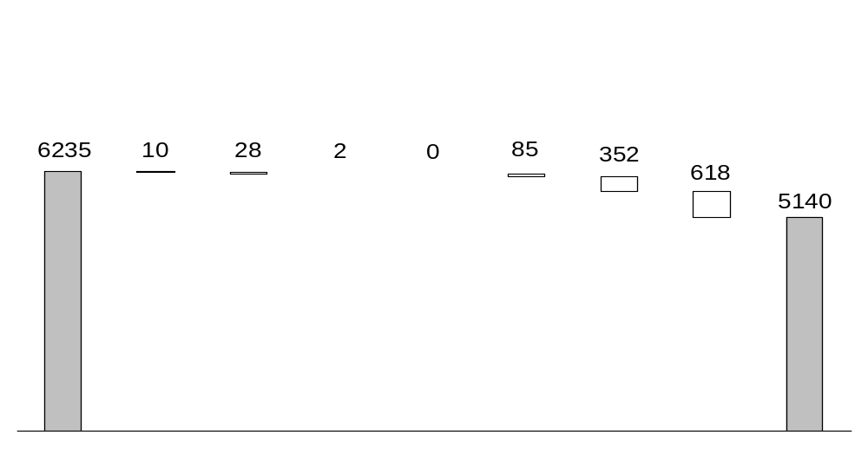
POPULATION SCREENING – VALIDATION
Screen #
1
2
3,4
5
6
7
8
All approved accounts
Major derog
Credit card bucket>3
BAM bucket>3
or
pass_due_amt>0
Cash card delinquent
Cash card utilization >=95%
(Credit + cash cards) balance >=500k
Data
Insufficient*
Base population
* W/o KRM001 or w/o KRM023 or IND001=1.

Slide 6
MODEL POPULATION SEGMENTATION
100% = 7,996
Model population
Pop: 100%
Regression model applied
Chaid tree model applied
Fail
prescreen
Pop: 37%
Pass
prescreen
Pop: 63%
Without
guarantor
Pop: 47%
CC limit*
>50k, <=100k
Pop: 16%
Screen #
1 - 5
Pop: 1%
Bad**: 16%
Screen #
6 - 8
Pop: 36%
Bad: 18%
With
guarantor
Pop: 16%
Bad: 1%
Credit card limit <=50k
Pop: 4%
Bad: 11%
CC not revolve in latest month
Pop: 5%
Bad: 4%
CC revolve in latest month
Pop: 11%
Bad: 10%
Credit card limit >100k
Pop: 27%
Bad: 3%
* Credit card limit(MS605): average limit of credit card line by issuer in the latest month within past 3 months - exclude limit=0.
** M4_28

Slide 7
VALIDATION POPULATION SEGMENTATION
100% = 6,235
Model population
Pop: 100%
Regression model applied
Chaid tree model applied
Fail
prescreen
Pop: 18%
Pass
prescreen
Pop: 82%
Without
guarantor
Pop: 45%
CC limit*
>50k, <=100k
Pop: 14%
Screen #
1 - 5
Pop: 1%
Bad**: 13%
Screen #
6 - 8
Pop: 17%
Bad: 15%
With
guarantor
Pop: 37%
Bad: 1%
Credit card limit <=50k
Pop: 3%
Bad: 12%
CC not revolve in latest month
Pop: 4%
Bad: 6%
CC revolve in latest month
Pop: 10%
Bad: 12%
Credit card limit >100k
Pop: 28%
Bad: 4%
* Credit card limit(MS605): average limit of credit card line by issuer in the latest month within past 3 months - exclude limit=0.
** M4_28

Slide 8
MODEL POPULATION SEGMENTATION
100% = 7,996
Model population
Pop: 100%
Regression model applied
Chaid tree model applied
Fail
prescreen
Pop: 37%
Pass
prescreen
Pop: 63%
Without
guarantor
Pop: 47%
CC limit*
>50k, <=100k
Pop: 16%
Screen #
1 - 5
Pop: 1%
Bad**: 16%
Screen #
6 - 8
Pop: 36%
Bad: 18%
With
guarantor
Pop: 16%
Bad: 1%
Credit card limit <=50k
Pop: 4%
Bad: 11%
CC not revolve in latest month
Pop: 5%
Bad: 4%
CC revolve in latest month
Pop: 11%
Bad: 10%
Credit card limit >100k
Pop: 27%
Bad: 3%
P0
P2
P3
P4
P5
* Credit card limit(MS605): average limit of credit card line by issuer in the latest month within past 3 months - exclude limit=0.
** M4_28

Slide 9
CONTENTS
Sample definition
Variable definition & range
Model lift charts / KS score
Population distribution by risk segment

Slide 10
MODEL BUILDING Y DEFINITION
M4_28
1, if (Bucket_EF_1k >=4 OR ACCT_STS = 3* ) for minimum 28 months to all tranches between 2003/4 and 2006/1
0, otherwise
* Account status 3 means entering into collection.

Slide 11
PRESCREEN VARIABLE DEFINITION
JAS002_DEFECT
APP_MAX_BUCKET
FS044
FS334
FS302
FS314B
MS602
Flag of major derogatory existence, including bad check, ever delinquent, ever reject, stop card; 1 if exists
Max bucket of credit lines
Number of loans with pass due amount>0
Max bucket of loans
Number of delinquent cash cards
Number of cash cards which utilization>=95%
Sum of average credit card revolving balance by issuer of the latest statement months in past 3 months and cash card balance

Slide 12
PRESCREEN VARIABLE DEFINITION (CONT.)
KRM001_HIT
KRM023_HIT
IND001
Flag of KRM023 data source existence; 1 if exists
Flag of KRM001 data source existence; 1 if exists
Flag of history of credit line is less than 6 months, with both KRM001 and KRM023 limitation; 1 if less than 6 months

Slide 13
POPULATION SEGMENTING VARIABLE DEFINITION
GUARANTOR
MS605
CDEF_FLAG_1M
Number of guarantors applicants have
Average limit of credit card line by issuer in the latest statement month within past 3 months - exclude limit=0
1 if accts with KRM023 pay-code in ('C', 'D', 'E', 'F') in the latest 1 months; otherwise 0

Slide 14
MODEL POPULATION SEGMENTATION
100% = 7,996
Model population
Pop: 100%
Regression model applied
Chaid tree model applied
Fail
prescreen
Pop: 37%
Pass
prescreen
Pop: 63%
Without
guarantor
Pop: 47%
CC limit*
>50k, <=100k
Pop: 16%
Screen #
1 - 5
Pop: 1%
Bad: 16%
Screen #
6 - 8
Pop: 36%
Bad: 18%
With
guarantor
Pop: 16%
Bad: 1%
Credit card limit <=50k
Pop: 4%
Bad: 11%
CC not revolve in latest month
Pop: 5%
Bad: 4%
CC revolve in latest month
Pop: 11%
Bad: 10%
Credit card limit >100k
Pop: 27%
Bad: 3%
P0
P2
P3
P4
P5
* Credit card limit(MS605): average limit of credit card line by issuer in the latest month within past 3 months - exclude limit=0.
** M4_28

Slide 15
SCORE CARD P0 FORMULA
Score=
0.11920
+
Flag of cash card delinquent; 1 if accts with, otherwise 0
*
0.16259
+
Flag of JAS002 defect; 1 if accts with, otherwise 0
*
0.08236

Slide 16
SCORE CARD P0 STEPWISE SUMMARY
Variable
Coefficient
Pr>|t|
VIF
Intercept
FS302_FG
JAS002_DEFECT_FG
0.11920
0.16259
0.08236
0.0385
0.1073
0.3913
0
1.08379
1.08379

Slide 17
VARIABLE – FS302_FG
DESCRIPTION
COEFFICIENT
TRANSFORMATION
SQL TABLE
SQL COLUMN
Flag of cash card delinquent; 1 if accts with, otherwise 0; transformed from FS302, which is number of delinquent cash cards
0.16259
if FS302>=1 then FS302_FG=1;
else FS302_FG=0;
FW_PLOAN.dbo.BAM086
ACCOUNT_CODE, PAY_CODE_12

Slide 18
VARIABLE – JAS002_DEFECT_FG
DESCRIPTION
COEFFICIENT
TRANSFORMATION
SQL TABLE
SQL COLUMN
Flag of JAS002 defect; 1 if accts with, otherwise 0
0.08236
if JAS002_DEFECT=1 then JAS002_DEFECT_FG=1;
else JAS002_DEFECT_FG=0;
FW_PLOAN.dbo.JAS002
DELINQUENT_DATE,BAD_CHECK_DATE,
REJECT_DATE,STOP_CARD_DATE

Slide 19
VARIABLE RANGE- MODELING POPULATION
Variable
Mean
Std Dev
Minimum
Maximum
FS302_FG JAS002_DEFECT_FG
0.23596 0.26966
0.42700 0.44630
0 0
1 1

Slide 20
VARIABLE RANGE- VALIDATION POPULATION
Variable
Mean
Std Dev
Minimum
Maximum
FS302_FG JAS002_DEFECT_FG
0 0.22222
0 0.42366
0 0
0 1

Slide 21
ORIGINAL VARIABLE RANGE- MODELING POPULATION
Variable
N
Mean
Std Dev
Minimum
Maximum
FS302 JAS002_DEFECT
0.27711 1
0.52529 0
0 1
3 1
83 24

Slide 22
ORIGINAL VARIABLE RANGE- VALIDATION POPULATION
Variable
N
Mean
Std Dev
Minimum
Maximum
FS302 JAS002_DEFECT
0 1
0 0
0 1
0 1
27 6

Slide 23
QUARTILE ASSIGMENT
Twentile
Cut point
0
2
3
4
=
<=
<=
>
missing
0.1192
0.20156
0.20156

Slide 24
MODEL POPULATION SEGMENTATION
100% = 7,996
Model population
Pop: 100%
Regression model applied
Chaid tree model applied
Fail
prescreen
Pop: 37%
Pass
prescreen
Pop: 63%
Without
guarantor
Pop: 47%
CC limit*
>50k, <=100k
Pop: 16%
Screen #
1 - 5
Pop: 1%
Bad: 16%
Screen #
6 - 8
Pop: 36%
Bad: 18%
With
guarantor
Pop: 16%
Bad: 1%
Credit card limit <=50k
Pop: 4%
Bad: 11%
CC not revolve in latest month
Pop: 5%
Bad: 4%
CC revolve in latest month
Pop: 11%
Bad: 10%
Credit card limit >100k
Pop: 27%
Bad: 3%
P0
P2
P3
P4
P5
* Credit card limit(MS605): average limit of credit card line by issuer in the latest month within past 3 months - exclude limit=0.
** M4_28

Slide 25
SCORE CARD P2 FORMULA
Score=
-0.02923
+
Flag of using cash advance (paycode CDEF) of credit line in past 9 months; 1 if accts with, otherwise 0
*
0.15400
+
CI #1 : monthly payment / average number of total credit lines (all opened) in past 9 months
0.00316
*
+
Flag of accounts with paycode CDEF of credit line in the past 1 month; 1 if accts with, otherwise 0
*
0.06766

Slide 26
SCORE CARD P2 STEPWISE SUMMARY
Variable
Coefficient
Pr>|t|
VIF
Intercept
FS016C_9M_t1
LN001_9M_t2
CDEF_FLAG_1M
-0.02923
0.15400
0.00316
0.06766
0.3419
0.0002
<.0001
0.0621
0
1.41674
1.22840
1.23029

Slide 27
VARIABLE – FS016C_9M_T1
DESCRIPTION
COEFFICIENT
TRANSFORMATION
SQL TABLE
SQL COLUMN
Flag of using cash advance (paycode CDEF) of credit line in past 9 months; 1 if accts with, otherwise 0
0.15400
if FS016C_9M=0 then FS016C_9M_t1=0;
else FS016C_9M_t1=1;
FW_PLOAN.dbo.KRM023
YRMON,ISSUE, PAY_CODE,CASH

Slide 28
VARIABLE – LN001_9M_T2
DESCRIPTION
COEFFICIENT
TRANSFORMATION
The interaction between flag of using cash advance (paycode CDEF) of credit line in past 9 months and the ratio of monthly payment, which equals internal monthly payment + external monthly payment + 0.35 x (credit card balance + cash card balance), to WI001_9M, which is average number of total credit lines in past 9 months
0.00316
LN001_9M=((MP_IN/1000)+(MS093B+(MS094C+MS105)
*0.35)) / WI001_9M;
if FS016C_9M=0 then FS016C_9M_t2=1;
else FS016C_9M_t2=0;
LN001_9M_t2=LN001_9M*FS016c_9M_t2;

Slide 29
VARIABLE – LN001_9M_T2 (CONT.)
SQL TABLE
SQL COLUMN
(1)FW_PLOAN.Oliver.statement2
(2)FW_PLOAN.dbo.KRM023
(3)FW_PLOAN.dbo.BAM086
(1)FST_LN_AMT,TOTAL_TERM,CRNT_IRATE
(2)YRMON,LIMIT,PAYMENT,PAY_CODE,ISSUE,CASH
(3)ACCOUNT_CODE,LOAN_AMT,PASS_DUE_AMT

Slide 30
VARIABLE – LN001_9M_T2 (CONT.)
DESCRIPTION
TRANSFORMATION
MP_IN: monthly payment of internal lending
MS093B: monthly payment of external lending
MS094B: average revolving balance of credit line (paycode CDEF) in past 3 months
MS105: total cash card balance
monthly_rate=APR / 12;
amortization_rate=(((1+(monthly_rate/100))**total_term)
*(monthly_rate/100))/(((1+(monthly_rate/100))**total_term)-1);
monthly_payment =loan_amount*amortization_rate;
if monthly_payment =. then MP_IN = 0;
else MP_IN = monthly_payment;
if MS094B=. then MS094C=0;
else MS094C=MS094B;

Slide 31
VARIABLE – CDEF_FLAG_1M
DESCRIPTION
COEFFICIENT
TRANSFORMATION
SQL TABLE
SQL COLUMN
Flag of accounts with paycode CDEF of credit line in the past 1 month; 1 if accts with, otherwise 0
0.06766
None
FW_PLOAN.dbo.KRM023
YRMON,PAY_CODE

Slide 32
VARIABLE RANGE- MODELING POPULATION
Variable
Mean
Std Dev
Minimum
Maximum
FS016C_9M_t1 LN001_9M_t2 CDEF_FLAG_1M
0.31921 15.80546 0.59605
0.46683 25.41804 0.49138
0 0 0
1 197.81731 1

Slide 33
VARIABLE RANGE- VALIDATION POPULATION
Variable
Mean
Std Dev
Minimum
Maximum
FS016C_9M_t1 LN001_9M_t2 CDEF_FLAG_1M
0.40933 10.86677 0.62176
0.49299 14.88535 0.48621
0 0 0
1 87.02534 1

Slide 34
ORIGINAL VARIABLE RANGE- MODELING POPULATION
Variable
N
Mean
Std Dev
Minimum
Maximum
FS016C_9M MP_IN MS093B MS094B MS105 WI001_9M CDEF_FLAG_1M
0.50282 7898.44 8.47 41.51796 21.48305 1.87790 0.59605
354 354 354 235 354 354 354
0.91648 3411.81 10.99076 38.28510 49.81662 1.20139 0.49138
0 1979.65 0 0.16667 0 0.22222 0
7 36706.82 111.9 220 391 8.77778 1

Slide 35
ORIGINAL VARIABLE RANGE- VALIDATION POPULATION
Variable
N
Mean
Std Dev
Minimum
Maximum
FS016C_9M MP_IN MS093B MS094B MS105 WI001_9M CDEF_FLAG_1M
0.64249 7070.08 8.95537 49.57210 0.48187 1.94013 0.62176
193 193 193 141 193 193 193
0.89655 2591.84 9.20712 45.64535 3.66016 1.32030 0.48621
0 2480.89 0 0.66667 0 0.22222 0
4 16069.41 60.04 373.33333 44 8.88889 1

Slide 36
TWENTILE ASSIGMENT
Twentile
Cut point
0
1
2
3
4
5
6
7
8
9
10
11
12
13
14
17
20
=
<=
<=
<=
<=
<=
<=
<=
<=
<=
<=
<=
<=
<=
<=
<=
>
missing
-0.01551
-0.00549
0.00562
0.01940
0.04620
0.05837
0.07083
0.07631
0.08300
0.09374
0.10974
0.12477
0.14445
0.18946
0.19243
0.19243

Slide 37
MODEL POPULATION SEGMENTATION
100% = 7,996
Model population
Pop: 100%
Regression model applied
Chaid tree model applied
Fail
prescreen
Pop: 37%
Pass
prescreen
Pop: 63%
Without
guarantor
Pop: 47%
CC limit*
>50k, <=100k
Pop: 16%
Screen #
1 - 5
Pop: 1%
Bad: 16%
Screen #
6 - 8
Pop: 36%
Bad: 18%
With
guarantor
Pop: 16%
Bad: 1%
Credit card limit <=50k
Pop: 4%
Bad: 11%
CC not revolve in latest month
Pop: 5%
Bad: 4%
CC revolve in latest month
Pop: 11%
Bad: 10%
Credit card limit >100k
Pop: 27%
Bad: 3%
P0
P2
P3
P4
P5
* Credit card limit(MS605): average limit of credit card line by issuer in the latest month within past 3 months - exclude limit=0.
** M4_28

Slide 38
P3 CHAID TREE SEGMENTATION
MAIN POPULATION
LU_FLAG=0
LU_FLAG=1
FS021_9M
<=2
FS021_9M
>2

Slide 39
VARIABLE – LU_FLAG
DESCRIPTION
TRANSFORMATION
Index indicates accounts who have low utilization and paid-in-full records on credit behavior, or, accounts have secured loans but no unsecured loan on loan lending behavior
if FS036 >0 then SECURE_FLAG=1;
else SECURE_FLAG=0;
if FS040 >0 then UNSECURE_FLAG=1;
else UNSECURE_FLAG=0;
if (MS118_9M <=0.2 and FS014_6M>=2) or (SECURE_FLAG=1 AND UNSECURE_FLAG=0) then LU_FLAG=1;
else LU_FLAG=0;

Slide 40
VARIABLE – LU_FLAG (CONT.)
Variable
Description
SQL TABLE*
SQL COLUMN
FS036 FS040 MS118_9M FS014_6M
Number of secured loan Number of unsecured loan Min revolving utilization in past 9 months – paycode CDEF Number of credit lines of transacting in past 6 months– paycode AB
dbo.BAM086 dbo.BAM086 dbo.KRM023 dbo.KRM023
ACCOUNT_CODE2 ACCOUNT_CODE2 YRMON LIMIT PAYMENT PAY_CODE YRMON ISSUE PAY_CODE
*All SQL table listed here located at FW_PLOAN

Slide 41
VARIABLE – FS021_9M
DESCRIPTION
TRANSFORMATION
SQL TABLE
SQL COLUMN
Number of months that revolved in at least one credit line in past 9 months
None
FW_PLOAN.dbo.KRM023
YRMON
PAY_CODE

Slide 42
VARIABLE RANGE – MODELING POPULATION
Variable
Mean
Std Dev
Minimum
Maximum
LU_FLAG FS021_9M
0.39189 1.95676
0.48883 2.80114
0 0
1 8

Slide 43
VARIABLE RANGE – VALIDATION POPULATION
Variable
Mean
Std Dev
Minimum
Maximum
LU_FLAG FS021_9M
0.41016 1.96875
0.49283 2.65223
0 0
1 8

Slide 44
ORIGINAL VARIABLE RANGE – MODELING POPULATION
Variable
N
Mean
Std Dev
Minimum
Maximum
MS118_9M FS014_6M FS036 FS040 FS021_9M
0.09761 1.93514 0.31104 2.17057 1.95676
0.18958 1.65315 0.53116 1.36384 2.80114
0 0 0 0 0
370 370 299 299 370
0.94118 10 3 9 8

Slide 45
ORIGINAL VARIABLE RANGE – VALIDATION POPULATION
Variable
N
Mean
Std Dev
Minimum
Maximum
MS118_9M FS014_6M FS036 FS040 FS021_9M
0.09431 1.67188 0.27184 2.02427 1.96875
0.20374 1.46654 0.53546 1.22749 2.65223
0 0 0 0 0
256 256 206 206 256
1.81818 8 3 6 8

Slide 46
MODEL POPULATION SEGMENTATION
100% = 7,996
Model population
Pop: 100%
Regression model applied
Chaid tree model applied
Fail
prescreen
Pop: 37%
Pass
prescreen
Pop: 63%
Without
guarantor
Pop: 47%
CC limit*
>50k, <=100k
Pop: 16%
Screen #
1 - 5
Pop: 1%
Bad: 16%
Screen #
6 - 8
Pop: 36%
Bad: 18%
With
guarantor
Pop: 16%
Bad: 1%
Credit card limit <=50k
Pop: 4%
Bad: 11%
CC not revolve in latest month
Pop: 5%
Bad: 4%
CC revolve in latest month
Pop: 11%
Bad: 10%
Credit card limit >100k
Pop: 27%
Bad: 3%
P0
P2
P3
P4
P5
* Credit card limit(MS605): average limit of credit card line by issuer in the latest month within past 3 months - exclude limit=0.
** M4_28

Slide 47
SCORE CARD P4 FORMULA
Score=
0.39859
+
Sum of balance of credit card, cash card and unsecured loan
*
0.00364
+
Number of months from the first credit line opening until now
*
-0.09671
+
Max delinquent amount of sum of all credit lines by month in past 12 months – M1+, paycode EF
*
0.00000207
+
Flag of cash using, including usage of cash advance and cash card
0.04757
*
+
JCIC inquiries (all)
0.00872
*
+
Ratio of number of delinquent credit lines (M1+, paycode DEF) to total number of credit lines (all opened) in past 6 months
0.09296
*
+
CI #4 : monthly payment / average amount of total credit line limit in past 9 months
0.04015
*
+
Number of newly opened loans (purpose code = 4) in past 9 months
*
0.01141

Slide 48
SCORE CARD P4 STEPWISE SUMMARY
Variable
Coefficient
Pr>|t|
VIF
Intercept
MS604_r
RS017_r_tran
MS001_12M_1K_q
FS3036_t5
FS031_tran4
INT053_6_q
LN004_9m_q
FS546_9m_tran
0.39859
0.00364
-0.09671
0.00000207
0.04757
0.00872
0.09296
0.04015
0.01141
0.0004
0.0091
<.0001
0.0015
0.0352
0.0657
0.0739
0.1545
0.1724
0
1.52934
1.04485
1.13238
1.10253
1.35094
1.11538
1.07039
1.56707

Slide 49
VARIABLE – MS604_R
DESCRIPTION
COEFFICIENT
TRANSFORMATION
SQL TABLE
SQL COLUMN
Sum of balance of credit card, cash card and unsecured loan
0.00364
MS604_r=MS604**0.5;
FW_PLOAN.dbo.KRM023
FW_PLOAN.dbo.BAM086
YRMON,LIMIT,PAYMENT,PAY_CODE
ACCOUNT_CODE, ACCOUNT_CODE2,LOAN_AMT, PASS_DUE_AMT

Slide 50
VARIABLE – RS017_R_TRAN
DESCRIPTION
COEFFICIENT
TRANSFORMATION
SQL TABLE
SQL COLUMN
Number of months from the first credit line opening until now
-0.09671
RS017_r=RS017**0.5;
if RS017_r>5 then RS017_r_tran=5;
else RS017_r_tran=RS017_r;
FW_PLOAN.dbo.KRM001
START_DATE

Slide 51
VARIABLE – MS001_12M_1K_Q
DESCRIPTION
COEFFICIENT
TRANSFORMATION
SQL TABLE
SQL COLUMN
Max delinquent amount of sum of all credit lines by month in past 12 months – M1+, paycode EF
0.00000207
MS001_12M_1K_q=MS001_12M_1K**2;
FW_PLOAN.dbo.KRM023
YRMON,PAYMENT,PAY_CODE

Slide 52
VARIABLE – FS3036_T5
DESCRIPTION
COEFFICIENT
TRANSFORMATION
Flag of cash using, including usage of cash advance and
cash card
0.04757
if FS018_12M=0 then FS018_12M_Z=1;
else FS018_12M_Z=0;
if FS309=0 then FS309_Z=1;
else FS309_Z=0;
if BAM009_HIT=1 then DO;
If FS018_12M_Z=0 or FS309_Z=0 then FS3036_t5=1;
else FS3036_t5=0;
END;
if BAM009_HIT=. then DO;
if FS018_12M_Z=0 then FS3036_t5=1;
else FS3036_t5=0;
END;

Slide 53
VARIABLE – FS3036_T5 (CONT.)
DESCRIPTION
SQL TABLE
SQL COLUMN
FS018_12M: Number of months using cash advance of
credit line in past 12 months
FS309: Number of lines of cash card in use ((Loan_amt +
Pass_due_amt) > 0) when in application
BAM009_HIT: Flag of BAM data source existence
FW_PLOAN.dbo.KRM023
FW_PLOAN.dbo.BAM086
YRMON,CASH
ACCOUNT_CODE,LOAN_AMT, PASS_DUE_AMT

Slide 54
VARIABLE – FS031_TRAN4
DESCRIPTION
COEFFICIENT
TRANSFORMATION
SQL TABLE
SQL COLUMN
JCIC inquiries (all)
0.00872
if FS031=. then FS031_tran4=0;
else if FS031>10 then FS031_tran4=10;
else FS031_tran4=FS031;
FW_PLOAN.dbo.STM001
QUERY_DATE,ITEM_LIST

Slide 55
VARIABLE – INT053_6_Q
DESCRIPTION
COEFFICIENT
TRANSFORMATION
SQL TABLE
SQL COLUMN
Ratio of number of delinquent credit lines (M1+, paycode DEF) to total number of credit lines (all opened) in past 6 months
0.09296
INT053_6=FS061_6M_1K/FS101_6M;
INT053_6_q=INT053_6**2;
FW_PLOAN.dbo.KRM023
YRMON,ISSUE,PAY_CODE

Slide 56
VARIABLE – LN004_9M_Q
DESCRIPTION
COEFFICIENT
TRANSFORMATION
SQL TABLE
SQL COLUMN
The ratio of monthly payment, which equals internal monthly payment + external monthly payment + 0.35 x (credit card balance + cash card balance), to WI004_9M, which is average amount of total credit line limit in past 9 months
0.04015
LN004_9m=((MP_IN/1000)+(MS093B+(MS094C+MS105)*0.35)) / WI004_9m;
LN004_9m_q=LN004_9m**2;
(1)FW_PLOAN.Oliver.statement2
(2)FW_PLOAN.dbo.KRM023 (3)FW_PLOAN.dbo.BAM086
(1)FST_LN_AMT,TOTAL_TERM,CRNT_IRATE (2)YRMON, PAYMENT, PAY_CODE(3)ACCOUNT_CODE,LOAN_AMT, PASS_DUE_AMT

Slide 57
VARIABLE – LN004_9M_Q (CONT.)
DESCRIPTION
TRANSFORMATION
MP_IN: monthly payment of internal lending
MS093B: monthly payment of external lending
MS094B: average revolving balance of credit line (paycode CDEF) in past 3 months
MS105: total cash card balance
monthly_rate=APR / 12;
amortization_rate=(((1+(monthly_rate/100))**total_term)*
(monthly_rate/100))/(((1+(monthly_rate/100))**total_term)-1);
monthly_payment =loan_amount*amortization_rate;
if monthly_payment =. then MP_IN = 0;
else MP_IN = monthly_payment;
if MS094B=. then MS094C=0;
else MS094C=MS094B;

Slide 58
VARIABLE – FS546_9M_TRAN
DESCRIPTION
COEFFICIENT
TRANSFORMATION
SQL TABLE
SQL COLUMN
Number of newly opened loans (purpose code = 4) in past 9 months
0.01141
if FS546_9M=. then FS546_9M_tran=0;
else FS546_9M_tran=FS546_9M;
FW_PLOAN.dbo.BAM086
DATA_YYY,DATA_MM,PURPOSE_CODE,
PAY_CODE_12

Slide 59
VARIABLE RANGE- MODELING POPULATION
Variable
Mean
Std Dev
Minimum
Maximum
MS604_r RS017_r_tran MS001_12M_1K_q FS3036_t5 FS031_tran4 INT053_6_q LN004_9M_q FS546_9M_tran
19.97687 4.85303 3620.56 0.28667 2.75812 0.07815 0.14531 1.87458
8.62769 0.43676 15920.47 0.45246 2.38638 0.19748 0.35679 1.45560
0.89443 2.64575 0 0 0 0 0.00025 0
48.47680 5 280900 1 10 1 8.55767 8

Slide 60
VARIABLE RANGE- VALIDATION POPULATION
Variable
Mean
Std Dev
Minimum
Maximum
MS604_r RS017_r_tran MS001_12M_1K_q FS3036_t5 FS031_tran4 INT053_6_q LN004_9M_q FS546_9M_tran
20.35550 4.85337 3195.07 0.33600 2.88000 0.06811 0.15989 1.51040
8.39642 0.44576 10771.48 0.47272 2.55265 0.16868 1.11044 1.32782
0.70711 2.64575 0 0 0 0 0.00015 0
65.25335 5 108900 1 10 1 27.56866 9

Slide 61
ORIGINAL VARIABLE RANGE- MODELING POPULATION
Variable
N
Mean
Std Dev
Minimum
Maximum
MS604 RS017 MS001_12M_1K BAM009_HIT FS018_12M FS309 FS031 MP_IN MS093B MS094B MS105 WI004_9M
473.42924 52.14782 25.96753 1 4.44569 0.55907 3.34812 8367.45 10.49441 117.67663 30.81411 282.25544
893 893 893 821 893 821 744 893 893 893 893 893
368.87114 25.33817 54.30977 0 4.71932 0.86700 2.37439 3313.07 10.31860 104.58254 63.58668 171.32391
0.8 7 0 1 0 0 1 2269.17 0 0.26667 0 35.55556
2350 226 530 1 12 5 16 29286.27 97.342 550 442 1205.56

Slide 62
ORIGINAL VARIABLE RANGE- MODELING POPULATION (CONT.)
Variable
N
Mean
Std Dev
Minimum
Maximum
INT053_6 FS061_6M_1K FS101_6M FS546_9M
0.14419 0.58119 4.61926 2.03898
893 893 893 821
0.23963 0.90549 2.47285 1.40329
0 0 1 0
1 5 16 8

Slide 63
ORIGINAL VARIABLE RANGE- VALIDATION POPULATION
Variable
N
Mean
Std Dev
Minimum
Maximum
MS604 RS017 MS001_12M_1K BAM009_HIT FS018_12M FS309 FS031 MP_IN MS093B MS094B MS105 WI004_9M
484.73321 50.67200 24.99040 1.00000 5.19040 0.04167 3.57988 7691.6 11.08259 138.33779 1.49600 273.77511
625 625 625 576 625 576 507 625 625 625 625 625
387.55027 25.72213 50.74120 0 4.855 0.2 2.47098 3148.63 11.57049 115.12971 8.45276 154.11617
0.5 7 0 1 0 0 1 1804.88 0 0.06667 0 33.33333
4258 192 330 1 12 1 14 24603.85 170.61 578.33333 87 986.55556

Slide 64
ORIGINAL VARIABLE RANGE- VALIDATION POPULATION (CONT.)
Variable
N
Mean
Std Dev
Minimum
Maximum
INT053_6 FS061_6M_1K FS101_6M FS546_9M
0.13925 0.57440 4.53600 1.63889
625 625 625 576
0.22091 0.87960 2.31129 1.30477
0 0 1 0
1 5 14 9

Slide 65
TWENTILE ASSIGMENT
Twentile
Cut point
0
1
2
3
4
5
6
7
8
9
10
11
12
13
14
15
16
17
18
19
20
=
<=
<=
<=
<=
<=
<=
<=
<=
<=
<=
<=
<=
<=
<=
<=
<=
<=
<=
<=
>
missing
-0.02452
0.00056
0.01786
0.03197
0.04325
0.05431
0.06485
0.07343
0.08346
0.09181
0.10081
0.11041
0.12171
0.13461
0.14597
0.16077
0.18534
0.20890
0.25620
0.25620

Slide 66
MODEL POPULATION SEGMENTATION
100% = 7,996
Model population
Pop: 100%
Regression model applied
Chaid tree model applied
Fail
prescreen
Pop: 37%
Pass
prescreen
Pop: 63%
Without
guarantor
Pop: 47%
CC limit*
>50k, <=100k
Pop: 16%
Screen #
1 - 5
Pop: 1%
Bad: 16%
Screen #
6 - 8
Pop: 36%
Bad: 18%
With
guarantor
Pop: 16%
Bad: 1%
Credit card limit <=50k
Pop: 4%
Bad: 11%
CC not revolve in latest month
Pop: 5%
Bad: 4%
CC revolve in latest month
Pop: 11%
Bad: 10%
Credit card limit >100k
Pop: 27%
Bad: 3%
P0
P2
P3
P4
P5
* Credit card limit(MS605): average limit of credit card line by issuer in the latest month within past 3 months - exclude limit=0.
** M4_28

Slide 67
SCORE CARD P5 FORMULA
Score=
0.25612
+
Total number of cash advance in past 12 months
*
0.00321
+
Number of months from the first credit line opening until now
*
-0.03459
+
Unsecured loan balance (purpose code=4), including this-time lending amount
*
0.00003294
+
Total number of credit lines revolved in past 3 months which credit lines opened less than a year – paycode CDEF
0.00225
*
+
CI #3 : monthly payment / average number of total credit lines (limit>200k) in past 9 months
*
0.00003516
+
JCIC inquiries (all) in past 30 days
0.00171
*
+
Sum of max bucket (paycode EF) of credit line by issuer in past 12 months
*
0.02631

Slide 68
SCORE CARD P5 STEPWISE SUMMARY
Variable
Coefficient
Pr>|t|
VIF
Intercept
FS016F_12M
RS017_r_tran2
MS074_t3
FS205_3M_1K_q_tran2
LN003_9M_t
FS031_1M_q_tran2
FS073B_12M_r
0.25612
0.00321
-0.03459
0.00003294
0.00225
0.00003516
0.00171
0.02631
0.0027
0.0187
0.0016
0.0335
0.0344
0.0774
0.0951
0.1118
0
1.21311
1.02525
1.03843
1.05850
1.21011
1.08913
1.03718

Slide 69
VARIABLE – FS016F_12M
DESCRIPTION
COEFFICIENT
TRANSFORMATION
SQL TABLE
SQL COLUMN
Total number of cash advance in past 12 months
0.00321
None
FW_PLOAN.dbo.KRM023
YRMON,ISSUE,CASH

Slide 70
VARIABLE – RS017_R_TRAN2
DESCRIPTION
COEFFICIENT
TRANSFORMATION
SQL TABLE
SQL COLUMN
Number of months from the first credit line opening until now
-0.03459
RS017_r=RS017**0.5;
if RS017_r>8 then RS017_r_tran2=8;
else RS017_r_tran2=RS017_r;
FW_PLOAN.dbo.KRM001
START_DATE

Slide 71
VARIABLE – MS074_T3
DESCRIPTION
COEFFICIENT
TRANSFORMATION
SQL TABLE
SQL COLUMN
Unsecured loan balance (purpose code=4), including this-time lending amount
0.00003294
if MS074=. then MS074_t1=0;
else MS074_t1=MS074;
LMT=loan_amount/1000;
MS074_t2=LMT+MS074_t1;
if MS074_t2>2250 then MS074_t3=2250;
else MS074_t3=MS074_t2;*
FW_PLOAN.Oliver.statement2; FW_PLOAN.dbo.BAM086
FST_LN_AMT
LOAN_AMT,PASS_DUE_AMT,PURPOSE_CODE
* Cap should be removed in production.

Slide 72
VARIABLE – FS205_3M_1K_Q_TRAN2
DESCRIPTION
COEFFICIENT
TRANSFORMATION
SQL TABLE
SQL COLUMN
Total number of credit lines revolved (>1K) in past 3 months which credit lines opened less than a year – paycode CDEF
0.00225
FS205_3M_1K_q=FS205_3M_1K**2;
if FS205_3M_1K_q=. then FS205_3M_1K_q_tran2=0;
else FS205_3M_1K_q_tran2=FS205_3M_1K_q;
FW_PLOAN.dbo.KRM001
FW_PLOAN.dbo.KRM023
ISSUE,START_DATE
YRMON,PAY_CODE

Slide 73
VARIABLE – LN003_9M_T
DESCRIPTION
COEFFICIENT
TRANSFORMATION
SQL TABLE
SQL COLUMN
The ratio of monthly payment, which equals internal monthly payment + external monthly payment + 0.35 x (credit card balance + cash card balance), to WI003_9M, which is average number of total credit lines (limit>200k) in past 9 months
0.00003516
if WI003_9M=0 then WI003_9M_t=0.1;
else WI003_9M_t=WI003_9M;
LN003_9m_t=((MP_IN/1000)+(MS093B+(MS094C+MS105)
*0.35)) / WI003_9M_t;
(1)FW_PLOAN.Oliver.statement2
(2)FW_PLOAN.dbo.KRM023 (3)FW_PLOAN.dbo.BAM086
(1)FST_LN_AMT,TOTAL_TERM,CRNT_IRATE(2)YRMON,LIMIT,PAYMENT,PAY_CODE(3)ACCOUNT_CODE,LOAN_AMT, PASS_DUE_AMT

Slide 74
VARIABLE – LN003_9M_T (CONT.)
DESCRIPTION
TRANSFORMATION
MP_IN: monthly payment of internal lending
MS093B: monthly payment of external lending
MS094B: average revolving balance of credit line (paycode CDEF) in past 3 months
MS105: total cash card balance
monthly_rate=APR / 12;
amortization_rate=(((1+(monthly_rate/100))**total_term)
*(monthly_rate/100))/(((1+(monthly_rate/100))**total_term)-1);
monthly_payment =loan_amount*amortization_rate;
if monthly_payment =. then MP_IN = 0;
else MP_IN = monthly_payment;
if MS094B=. then MS094C=0;
else MS094C=MS094B;

Slide 75
VARIABLE – FS031_1M_Q_TRAN2
DESCRIPTION
COEFFICIENT
TRANSFORMATION
SQL TABLE
SQL COLUMN
JCIC inquiries (all) in past 30 days
0.00171
FS031_1M_q=FS031_1M**2;
if FS031_1M_q=. then FS031_1M_q_tran2=0;
else if FS031_1M_q>100 then FS031_1M_q_tran2=100;
else FS031_1M_q_tran2=FS031_1M_q;
FW_PLOAN.dbo.STM001
QUERY_DATE,ITEM_LIST

Slide 76
VARIABLE – FS073B_12M_R
DESCRIPTION
COEFFICIENT
TRANSFORMATION
SQL TABLE
SQL COLUMN
Sum of max bucket (pay-code EF) of credit line by issuer in past 12 months
0.02631
FS073B_12M_r=FS073B_12M**0.5;
FW_PLOAN.dbo.KRM023
ISSUE,YRMON,PAY_CODE

Slide 77
VARIABLE RANGE- MODELING POPULATION
Variable
Mean
Std Dev
Minimum
Maximum
FS016F_12M RS017_r_tran2 MS074_t3 FS205_3M_1K_q_tran2 LN003_9M_t FS031_1M_q_tran2 FS073B_12M_r
4.74102 7.51118 1152.43 3.23472 409.12349 4.89361 0.36264
7.65696 0.97002 645.74166 10.93604 510.47195 9.77114 0.59924
0 2.82843 100 0 0.82085 0 0
54 8 2250 196 3152.74 100 3.31662

Slide 78
VARIABLE RANGE- VALIDATION POPULATION
Variable
Mean
Std Dev
Minimum
Maximum
FS016F_12M RS017_r_tran2 MS074_t3 FS205_3M_1K_q_tran2 LN003_9M_t FS031_1M_q_tran2 FS073B_12M_r
4.40123 7.47481 1212.05 3.60887 364.52431 4.27553 0.35261
7.35191 0.99911 650.86258 11.49290 458.86055 8.55775 0.58449
0 2.64575 100 0 2.58892 0 0
54 8 2250 144 2521.95 100 2.64575

Slide 79
ORIGINAL VARIABLE RANGE- MODELING POPULATION
Variable
N
Mean
Std Dev
Minimum
Maximum
MP_IN MS093B MS094B MS105 WI003_9M FS016F_12M RS017 MS074 LMT FS205_3M_1K FS031_1M FS073B_12M
11311.73 21.89718 166.40202 21.86374 0.66713 4.74102 73.90621 724.84485 673.46710 0.78765 1.46990 0.49043
2143 2143 1532 2143 2143 2143 2143 1953 2143 2138 2143 2143
7514.56 29.25393 149.92805 57.73414 0.93399 7.65696 30.13792 987.96001 420.26532 1.61960 1.65653 0.99803
1932.82 0 0.06667 0 0 0 8 0 100 0 0 0
200073.39 385.625 900 392 6.56 54 256 17010 3000 14 11 11

Slide 80
ORIGINAL VARIABLE RANGE- VALIDATION POPULATION
Variable
N
Mean
Std Dev
Minimum
Maximum
MP_IN MS093B MS094B MS105 WI003_9M FS016F_12M RS017 MS074 LMT FS205_3M_1K FS031_1M FS073B_12M
11504.78 25.43516 168.66 0.63468 0.66804 4.40123 72.42200 745.23533 716.36925 0.84243 1.42200 0.46577
1782 1782 1185 1782 1782 1782 1782 1636 1782 1777 1782 1782
5939.39 41.14550 149.62068 6.64683 0.91802 7.35191 29.15633 1248.4 430.90089 1.70616 1.51368 0.93091
1804.88 0 0.00667 0 0 0 7 0 100 0 0 0
44489.980 945.648 813.33333 129 9.22 54 262 26905 2000 12 12 7

Slide 81
TWENTILE ASSIGMENT
Twentile
Cut point
0
1
2
3
4
5
6
7
8
9
10
11
12
13
14
15
16
17
18
19
20
=
<=
<=
<=
<=
<=
<=
<=
<=
<=
<=
<=
<=
<=
<=
<=
<=
<=
<=
<=
>
missing
0.00317
0.01542
0.02500
0.03280
0.04108
0.04851
0.05467
0.06031
0.06764
0.07515
0.08255
0.09187
0.10131
0.11072
0.12268
0.13652
0.15577
0.17960
0.21736
0.21736

Slide 82
CONTENTS
Sample definition
Variable definition & range
Model lift charts / KS score
Population distribution by risk segment

Slide 83
MODEL POPULATION SEGMENTATION
100% = 7,996
Model population
Pop: 100%
Regression model applied
Chaid tree model applied
Fail
prescreen
Pop: 37%
Pass
prescreen
Pop: 63%
Without
guarantor
Pop: 47%
CC limit*
>50k, <=100k
Pop: 16%
Screen #
1 - 5
Pop: 1%
Bad: 16%
Screen #
6 - 8
Pop: 36%
Bad: 18%
With
guarantor
Pop: 16%
Bad: 1%
Credit card limit <=50k
Pop: 4%
Bad: 11%
CC not revolve in latest month
Pop: 5%
Bad: 4%
CC revolve in latest month
Pop: 11%
Bad: 10%
Credit card limit >100k
Pop: 27%
Bad: 3%
P0
P2
P3
P4
P5
* Credit card limit(MS605): average limit of credit card line by issuer in the latest month within past 3 months - exclude limit=0.
** M4_28

Slide 84
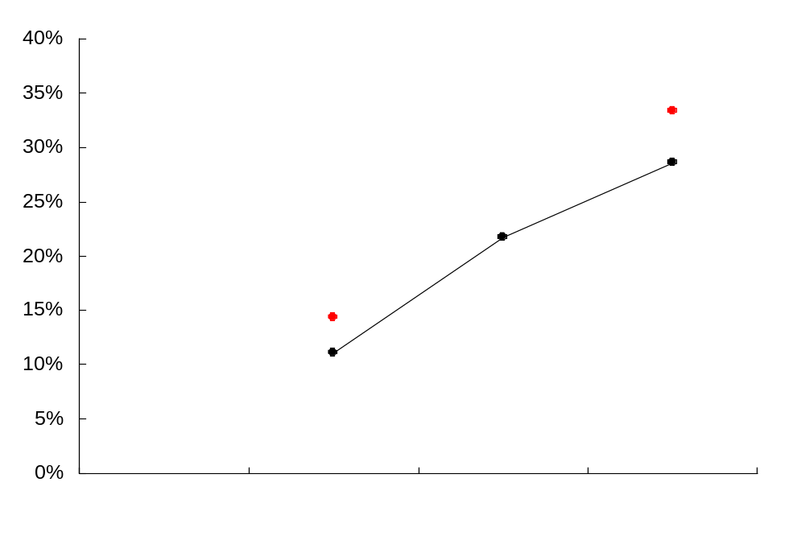
LIFT CHART - SCORE CARD P0
Validation
Modeling
Population ranked by quartile

Slide 85
MODEL POPULATION SEGMENTATION
100% = 7,996
Model population
Pop: 100%
Regression model applied
Chaid tree model applied
Fail
prescreen
Pop: 37%
Pass
prescreen
Pop: 63%
Without
guarantor
Pop: 47%
CC limit*
>50k, <=100k
Pop: 16%
Screen #
1 - 5
Pop: 1%
Bad: 16%
Screen #
6 - 8
Pop: 36%
Bad: 18%
With
guarantor
Pop: 16%
Bad: 1%
Credit card limit <=50k
Pop: 4%
Bad: 11%
CC not revolve in latest month
Pop: 5%
Bad: 4%
CC revolve in latest month
Pop: 11%
Bad: 10%
Credit card limit >100k
Pop: 27%
Bad: 3%
P0
P2
P3
P4
P5
* Credit card limit(MS605): average limit of credit card line by issuer in the latest month within past 3 months - exclude limit=0.
** M4_28

Slide 86
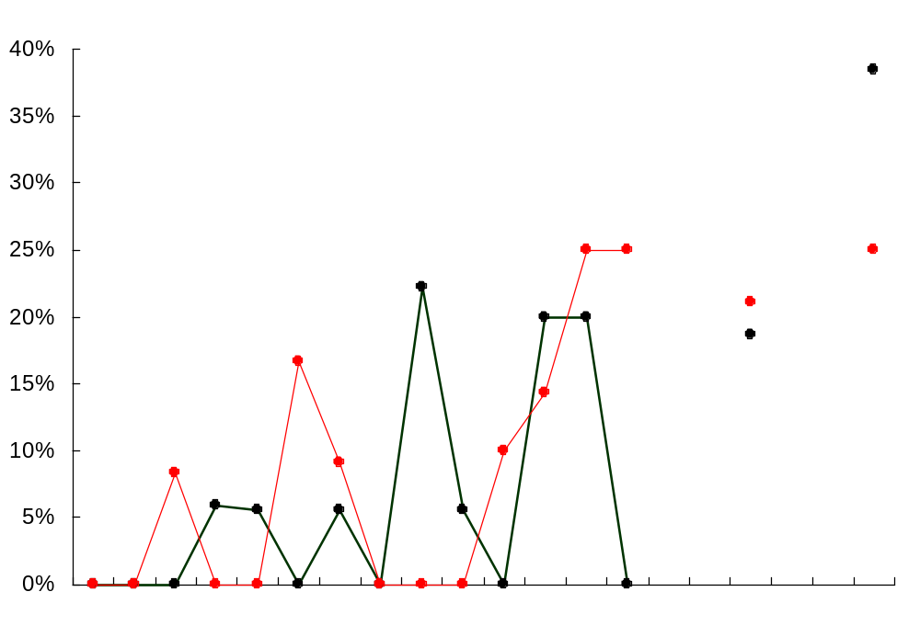
LIFT CHART - SCORE CARD P2
Modeling
Validation
Population ranked by twentile

Slide 87
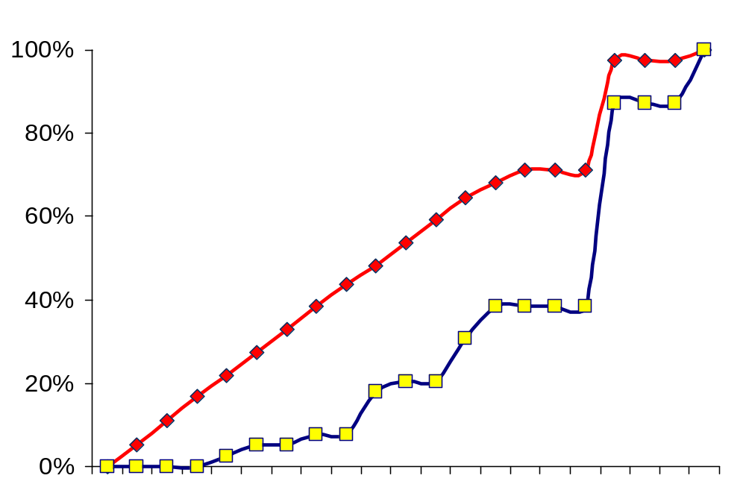
KOLMOGOROV-SMIRNOV(K-S) TEST- MODELING POPULATION
Cum good
39%
Cum bad
Population ranked by twentile

Slide 88
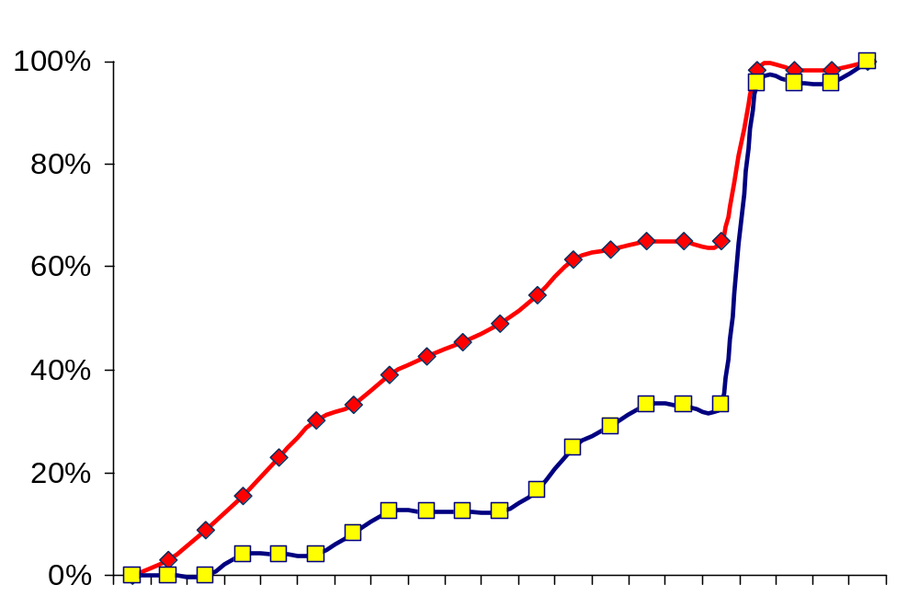
KOLMOGOROV-SMIRNOV(K-S) TEST- VALIDATION POPULATION
Cum good
38%
Cum bad
Population ranked by twentile

Slide 89
MODEL POPULATION SEGMENTATION
100% = 7,996
Model population
Pop: 100%
Regression model applied
Chaid tree model applied
Fail
prescreen
Pop: 37%
Pass
prescreen
Pop: 63%
Without
guarantor
Pop: 47%
CC limit*
>50k, <=100k
Pop: 16%
Screen #
1 - 5
Pop: 1%
Bad: 16%
Screen #
6 - 8
Pop: 36%
Bad: 18%
With
guarantor
Pop: 16%
Bad: 1%
Credit card limit <=50k
Pop: 4%
Bad: 11%
CC not revolve in latest month
Pop: 5%
Bad: 4%
CC revolve in latest month
Pop: 11%
Bad: 10%
Credit card limit >100k
Pop: 27%
Bad: 3%
P0
P2
P3
P4
P5
* Credit card limit(MS605): average limit of credit card line by issuer in the latest month within past 3 months - exclude limit=0.
** M4_28

Slide 90
P3 CHAID TREE SEGMENTATION
MAIN POPULATION
LU_FLAG=0
LU_FLAG=1
FS021_9M
<=2
FS021_9M
>2
Q1
Q2
Q3

Slide 91
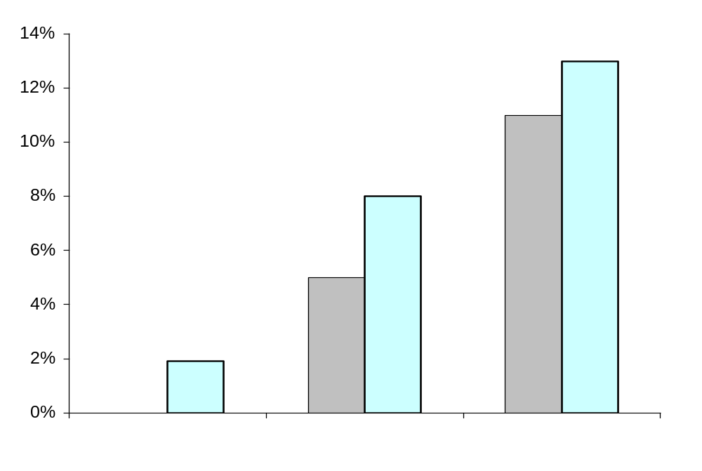
P3 BAD RATE BY TREE SEGMENT
Validation
Modeling
Q1
Q2
Q3
Population ranked by tree segment

Slide 92
MODEL POPULATION SEGMENTATION
100% = 7,996
Model population
Pop: 100%
Regression model applied
Chaid tree model applied
Fail
prescreen
Pop: 37%
Pass
prescreen
Pop: 63%
Without
guarantor
Pop: 47%
CC limit*
>50k, <=100k
Pop: 16%
Screen #
1 - 5
Pop: 1%
Bad: 16%
Screen #
6 - 8
Pop: 36%
Bad: 18%
With
guarantor
Pop: 16%
Bad: 1%
Credit card limit <=50k
Pop: 4%
Bad: 11%
CC not revolve in latest month
Pop: 5%
Bad: 4%
CC revolve in latest month
Pop: 11%
Bad: 10%
Credit card limit >100k
Pop: 27%
Bad: 3%
P0
P2
P3
P4
P5
* Credit card limit(MS605): average limit of credit card line by issuer in the latest month within past 3 months - exclude limit=0.
** M4_28

Slide 93
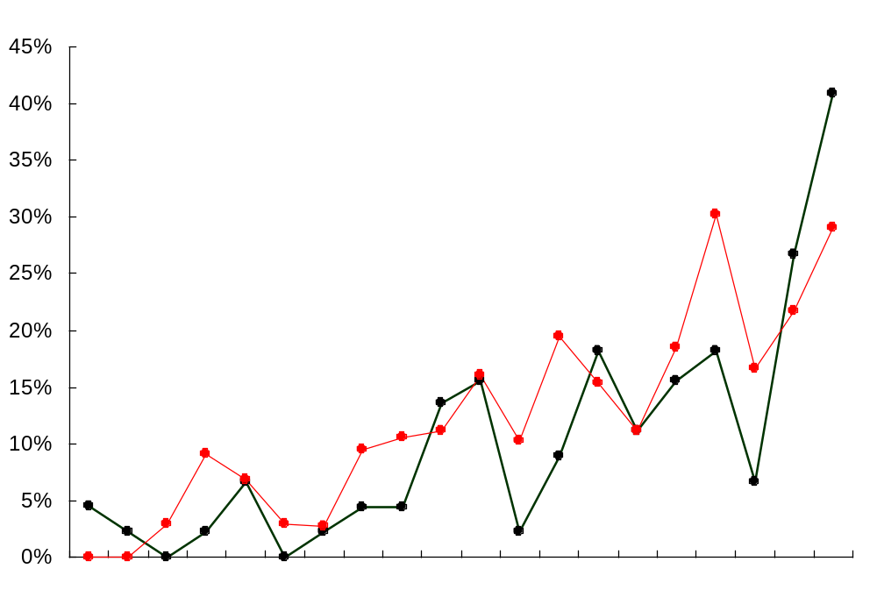
LIFT CHART - SCORE CARD P4
Modeling
Validation
Population ranked by twentile

Slide 94
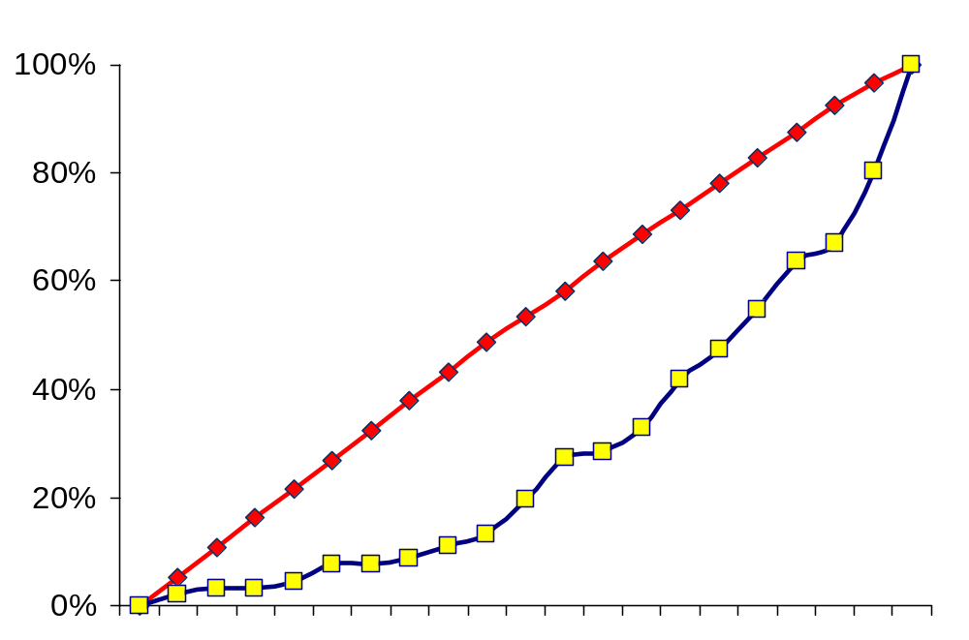
KOLMOGOROV-SMIRNOV(K-S) TEST- MODELING POPULATION
Cum good
36%
Cum bad
Population ranked by twentile

Slide 95
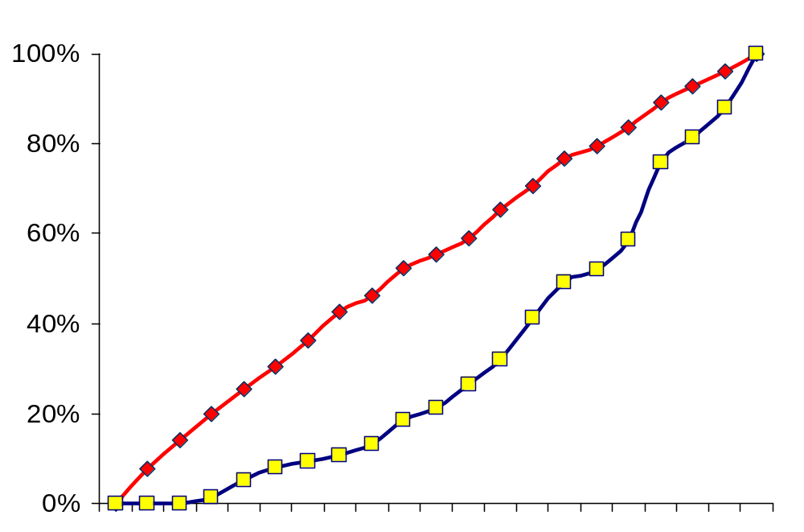
KOLMOGOROV-SMIRNOV(K-S) TEST- VALIDATION POPULATION
Cum good
34%
Cum bad
Population ranked by twentile

Slide 96
MODEL POPULATION SEGMENTATION
100% = 7,996
Model population
Pop: 100%
Regression model applied
Chaid tree model applied
Fail
prescreen
Pop: 37%
Pass
prescreen
Pop: 63%
Without
guarantor
Pop: 47%
CC limit*
>50k, <=100k
Pop: 16%
Screen #
1 - 5
Pop: 1%
Bad: 16%
Screen #
6 - 8
Pop: 36%
Bad: 18%
With
guarantor
Pop: 16%
Bad: 1%
Credit card limit <=50k
Pop: 4%
Bad: 11%
CC not revolve in latest month
Pop: 5%
Bad: 4%
CC revolve in latest month
Pop: 11%
Bad: 10%
Credit card limit >100k
Pop: 27%
Bad: 3%
P0
P2
P3
P4
P5
* Credit card limit(MS605): average limit of credit card line by issuer in the latest month within past 3 months - exclude limit=0.
** M4_28

Slide 97
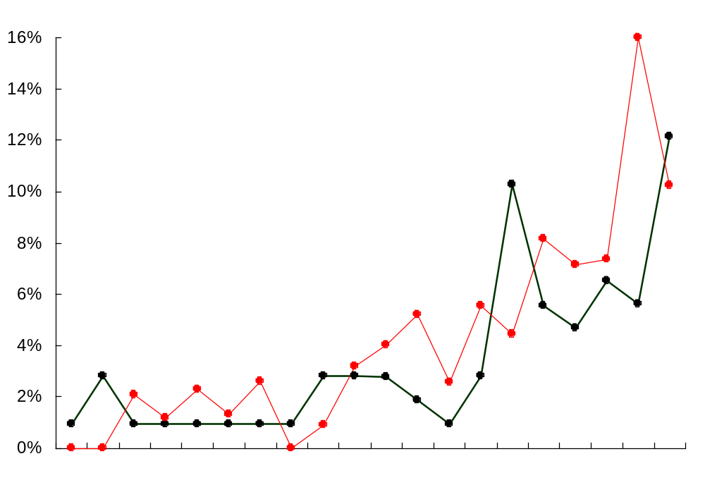
LIFT CHART - SCORE CARD P5
Modeling
Validation
Population ranked by twentile

Slide 98
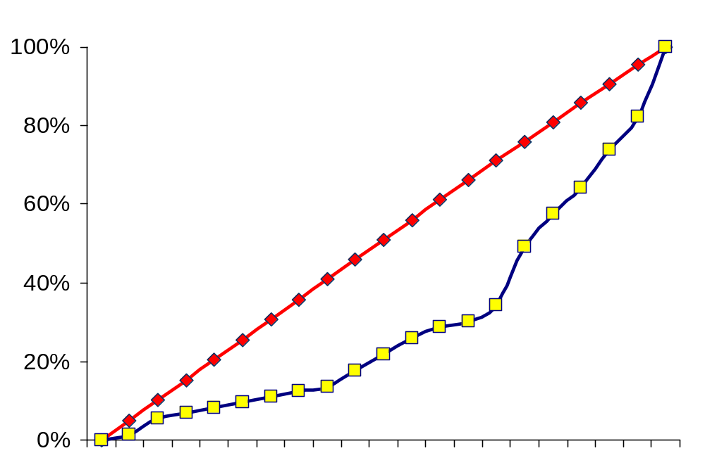
KOLMOGOROV-SMIRNOV(K-S) TEST- MODELING POPULATION
Cum good
37%
Cum bad
Population ranked by twentile

Slide 99
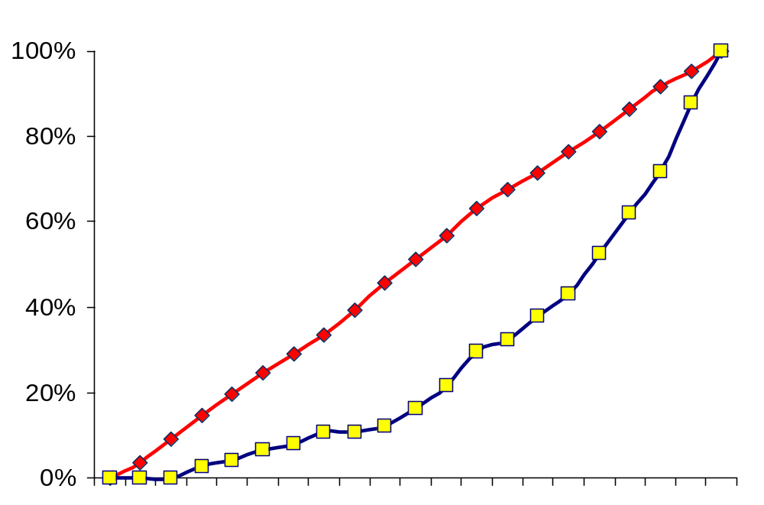
KOLMOGOROV-SMIRNOV(K-S) TEST- VALIDATION POPULATION
Cum good
35%
Cum bad
Population ranked by twentile

Slide 100
CONTENTS
Sample definition
Variable definition & range
Model lift charts / KS score
Population distribution by risk segment

Slide 101
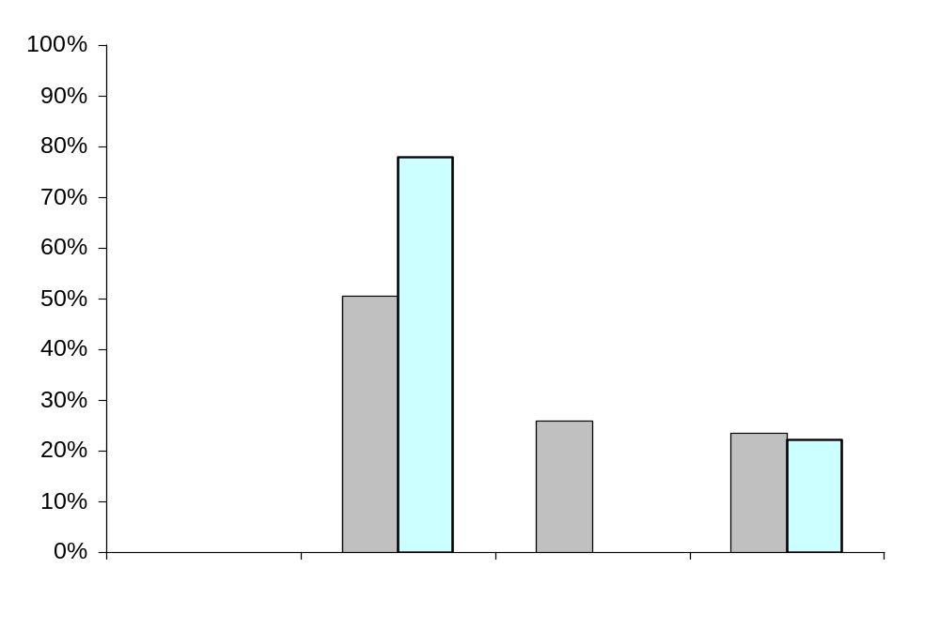
P0 POPULATION DISTIBUTION
Modeling
Validation
Population ranked by quartile

Slide 102
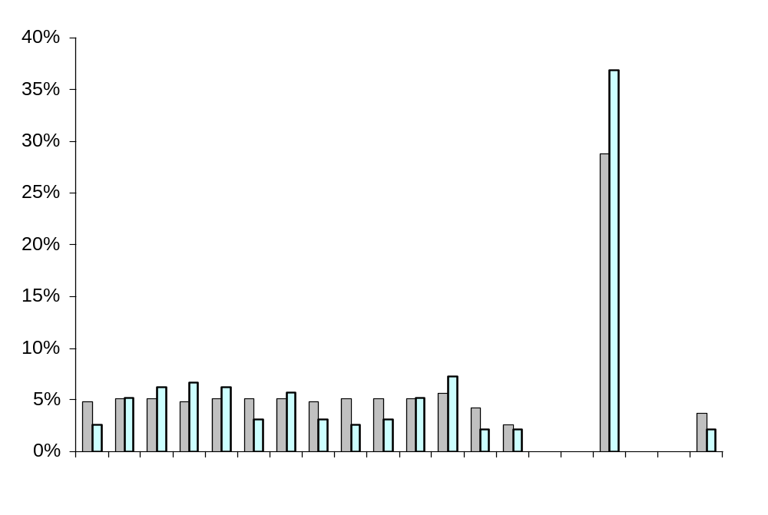
P2 POPULATION DISTIBUTION
Validation
Modeling
Population ranked by twentile

Slide 103
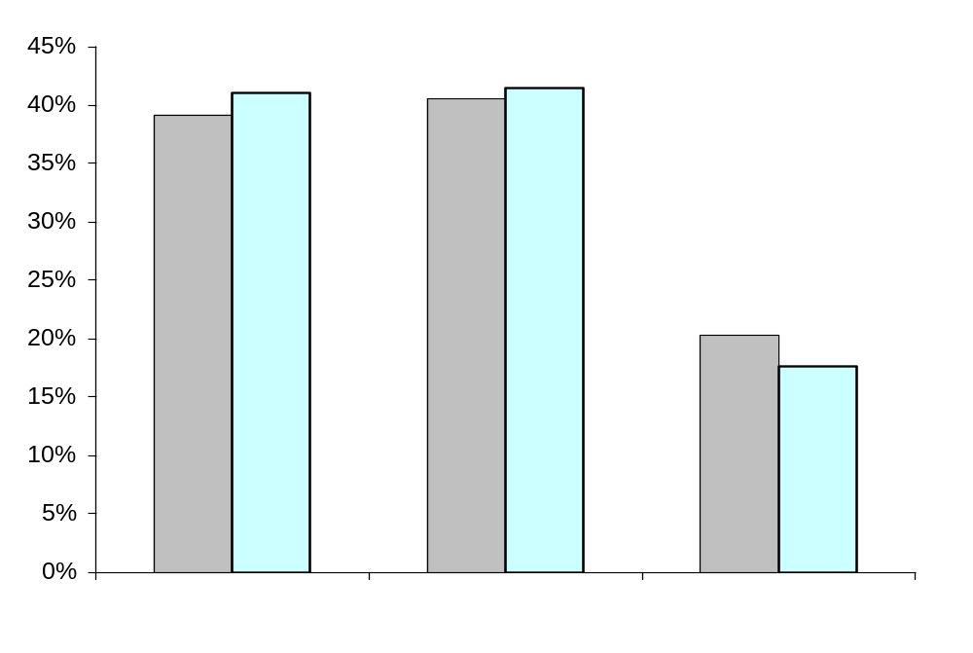
P3 POPULATION DISTIBUTION BY TREE SEGMENT
Modeling
Validation
Q1
Q2
Q3
Population ranked by tree segment

Slide 104
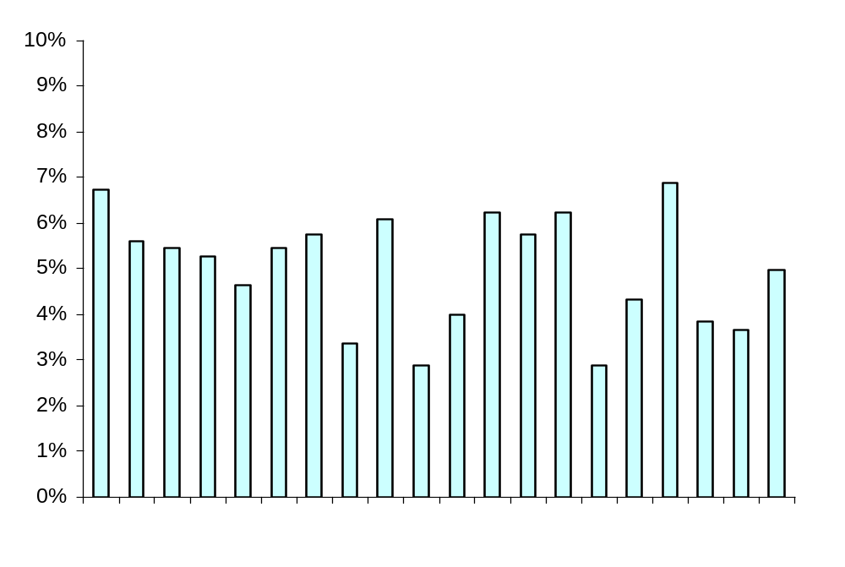
P4 POPULATION DISTIBUTION- VALIDATION POPULATION
Population ranked by twentile

Slide 105
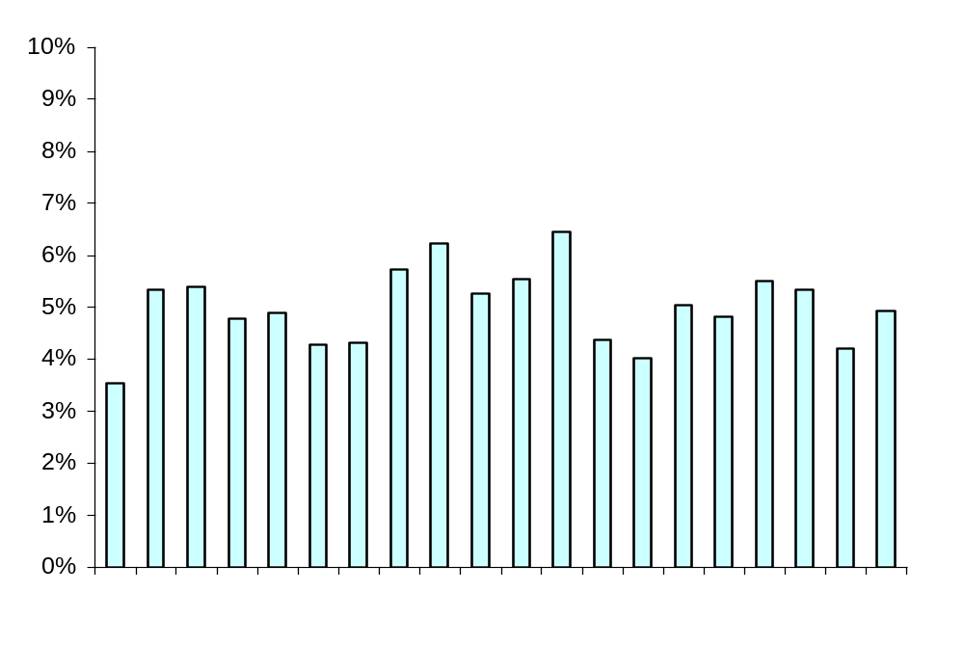
P5 POPULATION DISTIBUTION- VALIDATION POPULATION
Population ranked by twentile

